Slide 1

Bangladesh Army University of Engineering & Technology (BAUET)
Qadirabad, Natore-6431
Department of Computer Science and Engineering
Course Code: CSE-3200
Course Title: Integrated Design Project / Capstone Project
Project Presentation on “Custom Rom”
SUBMITTED BY | SUBMITTED TO
Name: Fathma Khatun Mim | Mohammed Golam Sarwar Bhuyan
ID:20104002 | Associate Professor & Head, Dept of CSE, BAUET
Name: Gourob Roy | Md. Muktar Hossain
ID:20104027 | Senior Lecturer, Dept. of CSE, BAUET
Name: Md. Arik Rayhan | Mithun Kumar
ID:20104033 | Senior Lecturer, Dept. of CSE, BAUET
Batch: 11th | Bristi Rani Roy
Year: 3rd | Lecturer, Dept. of CSE, BAUET
Semester: 2nd | Redoanul Haque
Session: 2020-2021 | Lecturer, Dept. of CSE, BAUET

Slide 2
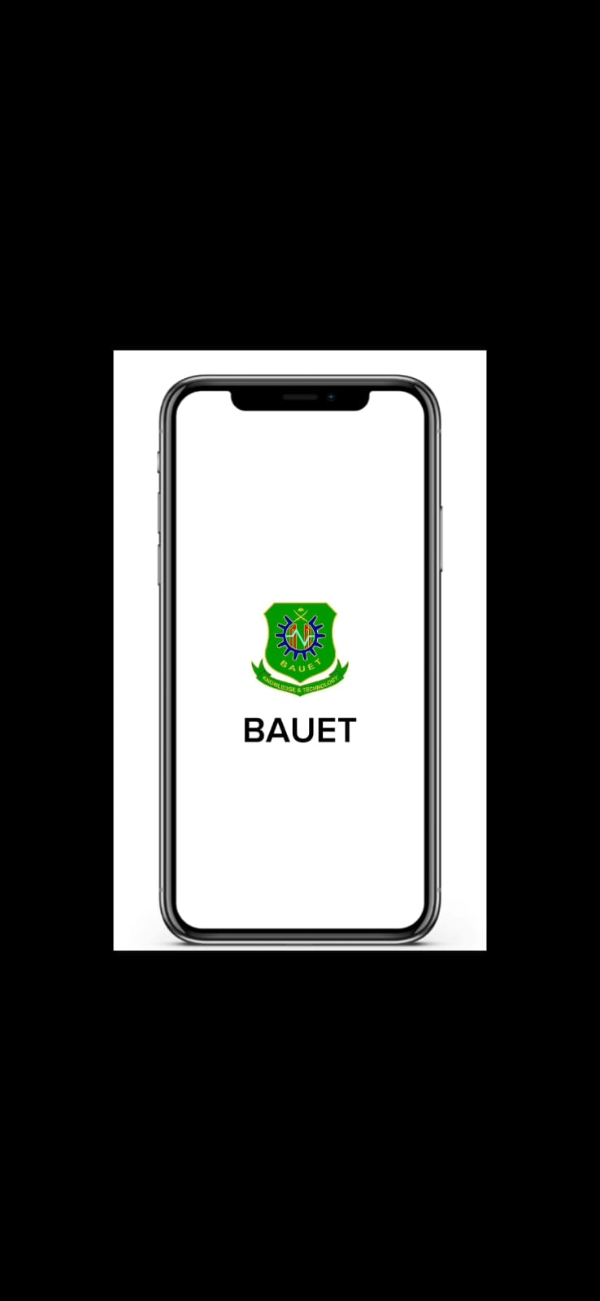
Introduction
A custom ROM is an aftermarket firmware production based on the Android source code provided by Google. It is essentially a modified version of the operating system that is available for Android devices. [1]

Slide 3
Problem Statement
Challenges in maintaining control over device usage for corporate organizations and parents.
Unrestricted app installations and access to inappropriate websites can cause productivity loss, security breaches, and harm to children.
Existing ROMs lack robust features for app installation control, website restrictions, and privacy protection.
Custom ROM needed to address these concerns and provide a secure and controlled mobile environment.

Slide 4

Motivation
Motivated by demand for control and privacy in corporate and parental settings.
Empowering organizations and parents with a secure digital ecosystem solution.
User-friendly custom ROM with advanced features addressing specific needs and concerns.

Slide 5
Objective
Custom ROM with robust app installation control mechanisms.
Privacy-focused ROM without bloatware and Google services.
Enhanced device management for remote monitoring and control.
Customizable and compatible ROM for organizations and parents' unique requirements.

Slide 6

Background Study
Comprehensive study of existing ROMs to identify gaps and limitations.
Analysis of app installation control, website restrictions, privacy, and device management capabilities.
Custom ROM development based on understanding strengths, weaknesses, and specific needs of target audience.

Slide 7
Existing System
ROMs lack robust app control and website restriction features.
Privacy concerns due to bloatware and tracking by Google services.
Limited device management capabilities hinder policy enforcement and monitoring.
Custom ROM needed for comprehensive control and privacy protection.

Slide 8
Comparative Analysis
Comparative analysis evaluates strengths and weaknesses of existing ROMs.
Custom ROM surpasses limitations with advanced features for control, restrictions, privacy, and management.
Comprehensive solution to address specific needs and concerns of target audience effectively.

Slide 9
Challanages
Device compatibility.
Robust control without performance compromise.
Privacy concerns.
Intuitive UI design.
Testing for stability.

Slide 10
Requirement Specification
The requirement specification encompasses the specific functionalities and features expected from our custom ROM.
These requirements include:
1. Robust mechanisms for app installation control.
2. Effective filtering mechanisms for website and host restrictions.
3. Elimination of bloatware and Google services while providing alternative functionalities.
4. Advanced device management features for remote monitoring and control.
5. Compatibility with a wide range of Android devices.

Slide 11

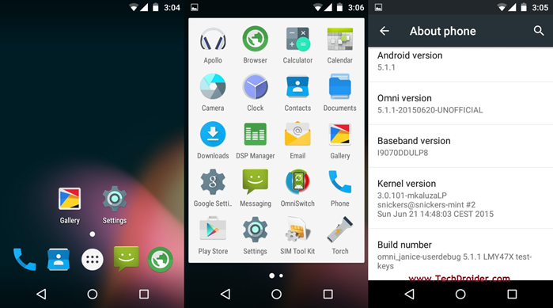

Design Specification
The design specification outlines the architectural and design considerations for our custom ROM.
It includes:
1. The architectural framework for app installation control and website restrictions.
2. Privacy-focused design principles and the elimination of bloatware and Google services.
3. The implementation of device management features and a user-friendly interface.
4. Compatibility considerations for different device configurations.

Slide 12
Impact on Society
Custom ROM: Secure, controlled mobile environment for organizations and parents.
Enhanced control: Increased productivity, reduced security risks.
Eliminate bloatware, prioritize privacy, contribute to secure digital ecosystem.
Customization and compatibility: Sustainable solution for evolving needs and technology.

Slide 13
Future Work
Future expansion: Incorporate user feedback and emerging trends, enhance capabilities of custom ROM.
Integration with parental control tools, improved device management, and enhanced privacy protection.
Commitment to continuous development and improvement to meet evolving user needs.

Slide 14
Conclusion
Custom ROM: Secure, controlled, and privacy-focused solution for corporate and parental control.
Robust app control, website restrictions, bloatware-free, and Google services-free experience.
Enhanced device management: Seamless administration, monitoring, and policy adherence.
Custom ROM: Positive impact on society through enhanced control, privacy, and security.

Slide 15
Reference
[1]“Explanation of some existing system” [Available on Online] https://beebom.com/, 12 September 2022
[2]“Explanation of some existing system” [Available on Online] https://www.pcmag.com/, 17 August 2022

Slide 16
ANY QUESTION

Slide 17
THANK YOU

